Slide 1
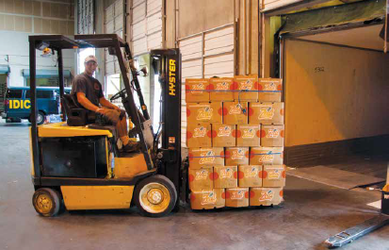
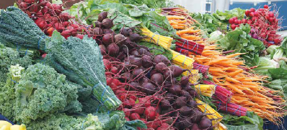
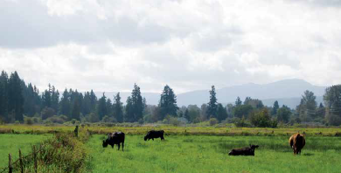
Measurement framework for the King County food system
Notes:
As the King County Kitchen Cabinet works towards the goals of a sustainable food economy and healthy food affordability, a few questions arise:
How do we know if we are reaching those goals?
How do we measure that progress collectively and collaboratively?

Slide 2
COLLABORATIVE EFFORTS
Mike Lufkin, Department of Natural Resources and Parks
Nadine Chan & Celeste Schoenthaler, Public Health Seattle-King County
Josh Monaghan and Mary Embleton, King Conservation District
Sharon Lerman, City of Seattle Office of Sustainability and Environment
Jane Reisman, ORS Impact
Tim Crosby, Slow Money NW / Thread Fund
Haley Millet, Consultant
Notes:
A group of us decided to answer those questions, including representatives from the major Kitchen Cabinet agencies as well as Tim Crosby of Slow Money NW and Jane Reisman, an evaluation consultant from ORS Impact.

Slide 3
WHY IS THIS IMPORTANT?
“Develop a local food system data collection system”
- Kitchen Cabinet Overarching Action Item #1
This measurement framework will…
Guide agency decisions and actions
Coordinate policy efforts
Clarify data needs
Garner political support
Notes:
Food systems measurement and data collection was the first broad action item listed in the Local Food Initiative, so this is a natural next step.
The measurement framework we created takes a systems approach, transcending silos and potentially geographic boundaries.
It will guide agency decisions and actions, coordinate policy efforts, and clarify data needs across the diverse sectors and stakeholders that make up our food system.
It will also garner political support by providing a way for interested parties to understand the food system and come alongside existing work.

Slide 4
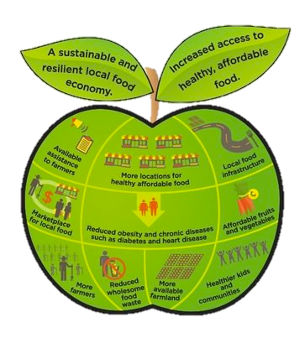
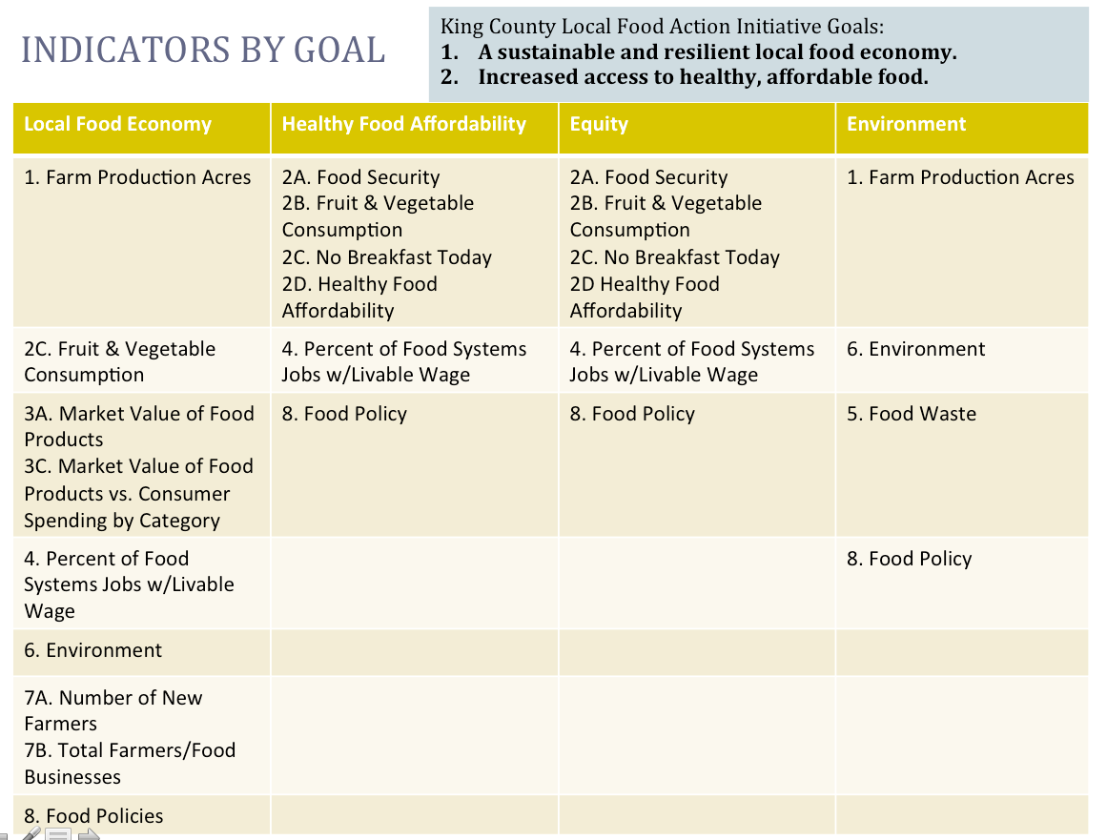
PROCESS OVERVIEW
1. Conducted a landscape scan of other successful food system evaluation efforts
2. Adapted these models to fit King County Local Food Initiative goals, strategies, and measurements
3. Generated a dashboard of Primary Indicators
Notes:
In order to develop this model, we looked at other successful food systems evaluation efforts across the country. We structured the framework largely based on the Vermont Farm to Plate Initiative, but also considered work in the greater Philadelphia region and in Iowa as well.
We then adapted these models to fit the measurements, strategies, and goals outlined in the Local Food Initiative. From 140 LFI priorities and even more numerous measurements, we generated a dashboard of 9 primary indicators.

Slide 5
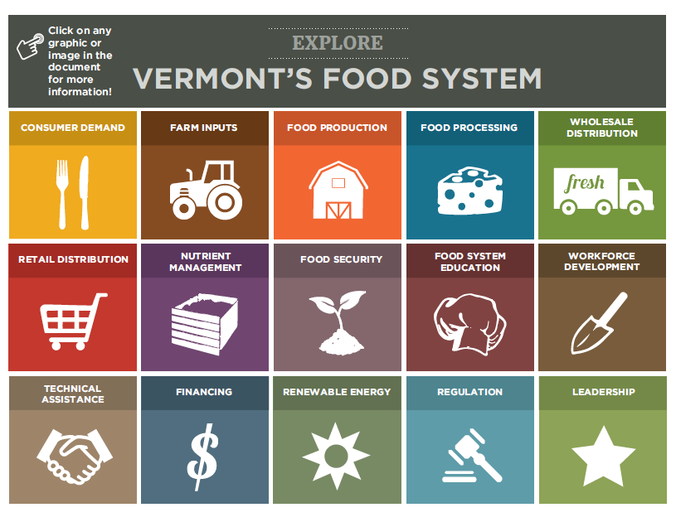
Notes:
This is the dashboard for the Vermont Farm to Plate Initiative. Behind each square on the dashboard, there are numerous related metrics. We began by attempting to replicate this dashboard for King and several other Washington counties, but soon found that the work in Vermont did not exactly match with work in our state.

Slide 6
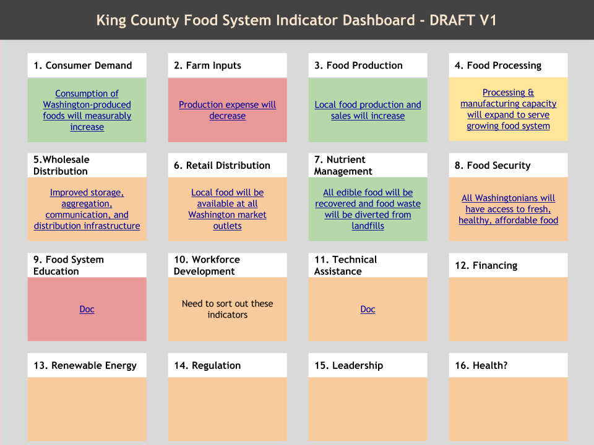
Notes:
We began to revise the dashboard to fit the Local Food Initiative work. In some areas, we combined dashboard categories to simplify. In other areas, such as Health, we created a new category.

Slide 7
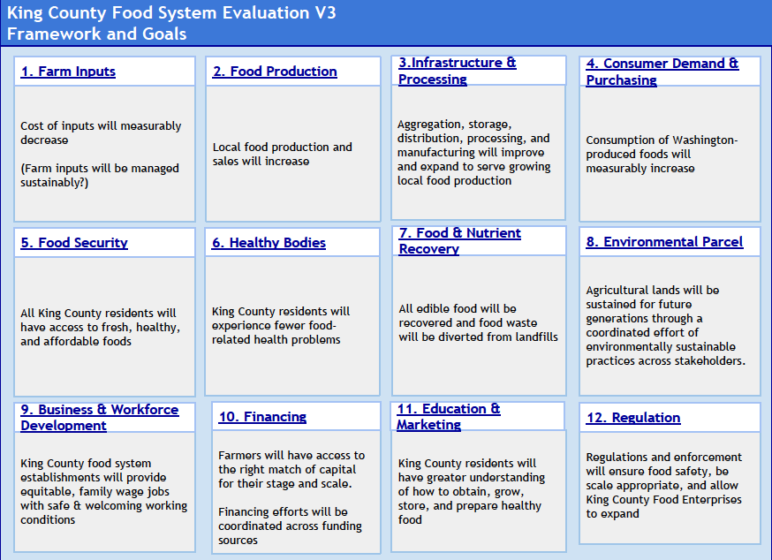
Notes:
We settled on 12 overarching goal categories with draft goal statements. Where available, goal statements were gleaned from the Local Food Initiative.

Slide 8
Notes:
This Indicators at a Glance dashboard displays all the metrics from the Local Food Initiative, organized onto the dashboard categories. Datasets in black have reliable, regular, and/or accurate data collection going on behind them. Red data sets are in need of data refinement or collection. As you can see, there are quite a few metrics we would like to know and measure as we carry out the Local Food Initiative, but we don’t have the data.

Slide 9
PRIMARY INDICATOR SELECTION
Podium Power | Is the indicator compelling? Does the indicator tell a story?
Proxy Power | Is this indicator of central importance to the result? Does it represent a needle we are trying to move in the food system? Which needle is it?
Data Power | Is there reliable, regular, and accurate data behind the indicator?
For more information on these tools, see the Indicator Selection page of the Results Based Accountability Implementation Guide @ http://raguide.org/
Notes:
Next, we continued to simplify and refine the measurement framework by selecting 9 primary indicators from the Indicators at a Glance dashboard.
In order to select those primary indicators we used Results Based Accountability tools of Podium, Proxy, and Data Power. Each indicator is ranked based on these three values. Podium Power denotes how compelling the indicator is to a consumer audience. Proxy Power signifies how well the indicator represents a needle we want to move in the food system. And lastly, Data Power communicates to what degree the indicator has regular, accurate, and reliable data collection behind it.
As you can see from this table, not every indicator in the framework ranks highly in all three categories. Indicators with high podium and proxy power but low data power are our first priorities for data collection and refinement, because we want those indicators but don’t have them. Those indicators have been compiled into a data development agenda.

Slide 10
INDICATORS BY GOAL
King County Local Food Action Initiative Goals:
1. A sustainable and resilient local food economy.
2. Increased access to healthy, affordable food.
Local Food Economy | Healthy Food Affordability | Equity | Environment
1. Farm Production Acres | 2A. Food Security 2B. Fruit & Vegetable Consumption 2C. No Breakfast Today 2D. Healthy Food Affordability | 2A. Food Security 2B. Fruit & Vegetable Consumption 2C. No Breakfast Today 2D Healthy Food Affordability | 1. Farm Production Acres
2C. Fruit & Vegetable Consumption | 4. Percent of Food Systems Jobs w/Livable Wage | 4. Percent of Food Systems Jobs w/Livable Wage | 6. Environment
3A. Market Value of Food Products 3C. Market Value of Food Products vs. Consumer Spending by Category | 8. Food Policy | 8. Food Policy | 5. Food Waste
4. Percent of Food Systems Jobs w/Livable Wage |  |  | 8. Food Policy
6. Environment
7A. Number of New Farmers 7B. Total Farmers/Food Businesses
8. Food Policies
Notes:
Here, the current 9 primary indicators can be seen organized by overarching Local Food Initiative goals including Local Food Economy, Healthy Food Affordability, Environment, and Equity. As you can see, there are indicators that touch all four goal areas – some touching more than one at the same time.

Slide 11
WHAT DID WE LEARN?
We want to apply a cross-sector approach to food systems measurement.
We want the framework to be scalable to micro (city) and macro (region) levels.
There are a few indicators that rise to the top.
There are very informative, compelling indicators for which we need to collect or improve data.
Notes:
This process has given us a prototype framework for food systems measurement. We learned that a cross-sector approach is important to represent the work of all agencies involved in food systems work -- kitchen cabinet and beyond.
We also learned that this model should be moldable to regional and city levels, facilitating communication between geographic scales.
We learned that even amongst the 9 primary indicators, there are a few that rise to the top as especially informative and touching many sectors – one example of this is Food Security.
Lastly, we learned that we are not currently measuring everything we want to. There are informative and compelling indicators that change the way we make decisions, but for which there is not reliable data.

Slide 12
HOW TO ENGAGE
We are seeking partners to validate the model.
Engage in next stage development of:
Indicators
Data Development
Data Narratives & Communication
Haley Millet
haley.rose.millet@gmail.com
206.293.4020

